Slide 1

Welcome to TCAT

Slide 2
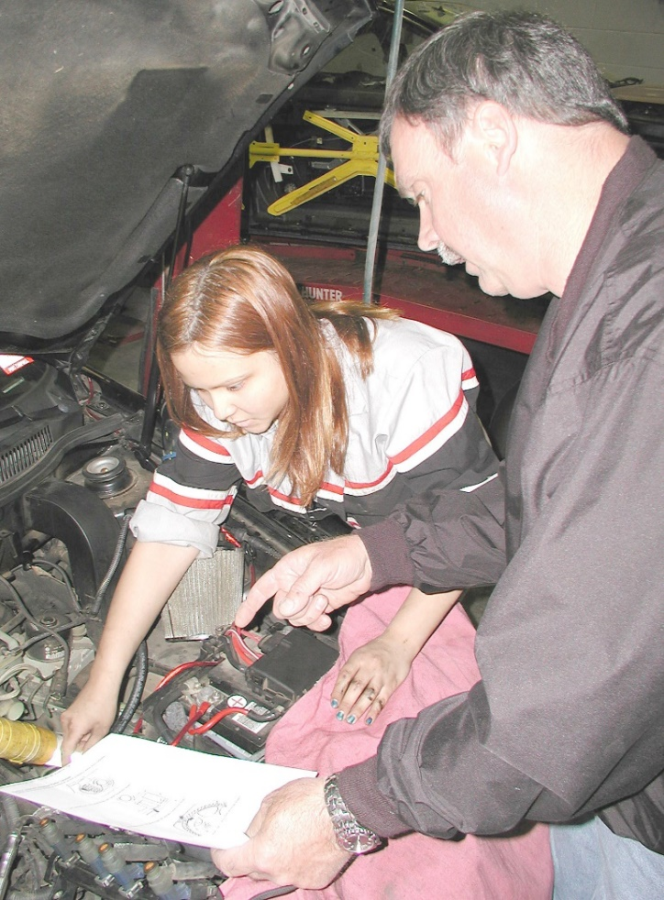
Agenda
Complete registration paperwork
Discuss college policies
Financial aid summary review
Schedule to tour the program
We’re so excited you’re here!
Notes:
I would like to welcome you to TCAT Dickson. We are happy you have chosen us for your training needs. Today we will give you important information regarding the policies you will need to understand to be successful at our college.
You should have received a packet of registration paperwork. Please complete each page completely and bring it with you on your first day of class.
If you have not had the opportunity to tour your chosen program and you would like to schedule a visit, please contact the college and make an appointment.

Slide 3
COVID-19 Care
New student orientation

Slide 4
COVID Precautions
These precautions have been put into place:
Application of PreventX 24/7 - kills viruses on contact and continues to kill germs for months
Social Distancing of 3 feet in classrooms and hallways is encouraged.
Masks are no longer required unless returning to campus after a confirmed positive Covid case.
Frequent healthy hygiene practices such as handwashing
Frequent cleaning/disinfecting of workspaces and study areas
COVID-19 CARE -
Safety Guidelines
Notes:
Our facilities staff have taken additional precautions that include regular cleaning of frequently touched surfaces and they have applied PreventX that kills viruses on contact and continues to kill germs for months.

Slide 5
COVID SCREENINGS
With the recent signing of the Omnibus Bill regarding Covid:
TCAT Dickson will no longer be screening students for illness or contact tracing.
If you test positive for Covid, your return to campus is a decision to be made by you and your health care provider. However, the TN Department of Health recommends Covid positive individuals isolate for five days after testing positive or the date of onset of symptoms. Students may then return to campus with improving symptoms and fever free for at least 24 hours without fever reducing medications. Upon returning to campus, students must wear a well-fitting mask when around others
for an additional 5 days.
COVID-19 CARE -
Safety Guidelines
Notes:
Our facilities staff have taken additional precautions that include regular cleaning of frequently touched surfaces and they have applied PreventX that kills viruses on contact and continues to kill germs for months.

Slide 6
COVID ABSENTEEISM
Covid absences will be treated like any other sickness or absence. Students should keep all documentation related to doctor’s visits, testing, etc. should they need it for an attendance appeal.
Positive students who remain off campus for more than 10 days due to COVID will be required to submit a note from a medical provider for any continued absences.
COVID-19 CARE -
Absenteeism
Notes:
Our facilities staff have taken additional precautions that include regular cleaning of frequently touched surfaces and they have applied PreventX that kills viruses on contact and continues to kill germs for months.

Slide 7
COVID ABSENTEEISM
Students with Covid Positive Children
Students (parents) who stay home because their young children have tested positive for COVID will be treated with
the same rules as previously stated. Again, they will need to maintain all medical documentation for a possible future attendance appeal.
COVID-19 CARE -
Absenteeism
Notes:
Our facilities staff have taken additional precautions that include regular cleaning of frequently touched surfaces and they have applied PreventX that kills viruses on contact and continues to kill germs for months.

Slide 8
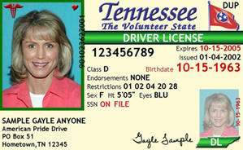

Your photograph will be taken for your Student ID Badge
on the first day of on-ground classes. Please present a government-issued ID card to verify your identity.
Notes:
You had your picture taken to receive your school ID. Please bring a government-issued ID card like your driver’s license or your military ID. Please have that ready to show us as we take your photo. We need to verify you are who you say you are. After that, your college ID will be your official ID on campus.

Slide 9
Who Governs TCAT?
TENNESSEE HIGHER EDUCATION COMMISSION
Oversees most public higher education institutions in TN
TENNESSEE BOARD of REGENTS
UNIVERSITY of TENNESSEE System
24
TCAT’s
13
COMMUNITY COLLEGES
Notes:
It’s important you know who we are and who governs the TCAT’s.
In TN, most post-secondary colleges are governed by THEC (TN Higher Education Commission).
Under THEC, there are 2 main governing institutions – Tennessee Board of Regents & the University of Tennessee system.
TBR – TN Board of Regents, which is who governs the TCAT’s. THEC is the 6th largest system of higher education in the country. TBR consists of:
a. 13 community colleges – like Nashville State and Columbia State
b. 27 Colleges of Applied Technology– There are really more because some TCATS have extension campuses. For instance, the Clarksville campus is an extension campus of TCAT Dickson.
2. UT – University of TN System, which consists of the UT colleges, ex: UT Knoxville, UT Martin, etc…

Slide 10

ACCREDITATION is important!
Accredited Institution
The Tennessee College
of Applied Technology
is accredited by the
Commission of the
Council on
Occupational Education
Notes:
TCAT Dickson is an accredited institution.
Accreditation is a status granted to an educational institution that meets or exceeds standards and criteria of educational quality and student achievement. The purpose of an accreditation is to ensure the college is fulfilling their mission, meeting curriculum objectives and established completion, placement, and licensure standards. It’s like a stamp of approval.
Once you graduate, you will complete an exit interview with updated employment and contact information. As part of our accreditation process, we have to complete a report each year that gives statistics on our graduates. It’s very important that you keep us updated on your employment after you graduate.

Slide 11

The TCAT Mission
“…Career in a Year…”
…to be Premier Supplier of
Workforce Development
“Career in a Year”
Notes:
We are the state’s premier providers of workforce development.
Our main goal is to provide you with state-of-the-art technical training so you can obtain the technical skills and professional training necessary for advancement in today's competitive job market …
… and all in 12-20 months
TCAT’s offer certificate and diploma programs in more than 50 different occupational fields as well as specialized training for business and industry.

Slide 12
Completion Rate
Do the Research We Stand by Our Numbers!
83% of our students complete their program for a credential!
In-Demand Careers
60% of today’s career jobs require high-tech skills –
what TCAT’s teach!
Placement Rate
85% of our graduates are employed in their field of study!
Notes:
Do you know of University graduates with Bachelors’, or even Masters’ degrees, that are unemployed or underemployed? The market is flooded with graduates that may be over-educated for entry level jobs.
The curricula taught at TCATS are for skilled trade careers. These career job opportunities exist, they’re in high demand, and they’re paying high dollar salaries! And they can change your life!
Are you convinced now you’re in a great college?

Slide 13
TCAT
Even Warranties Your Training!
Employers may file a warranty claim on a specific skill
You will receive a Warranty Card and Warranty Certificate with final certificate or diploma
Good for one year after graduation
Notes:
TCATS’s provide a warranty for your education up to one year after you graduate.
If for some reason your employer deems you unable to perform a specific skill from your training, the employer may file a warranty claim with the TN Board of Regents. Once approved, TBR will allow for you to be re-trained in the specific skill at no cost to you or the employer. A Warranty card and certificate are given to you with your final certificate or diploma for you to show your employer.
Wouldn’t that be impressive in an interview?

Slide 14
ANNUAL DISCLOSURE REQUIREMENTS
Notice of Federal Student Financial Aid Penalties for Drug Law Violations
A conviction for any offense under any federal or state law involving the possession or sale of illegal drugs, during a period of enrollment when receiving federal aid, will result in the loss of eligibility for any Title IV, HEA grant, loan, or work study assistance. A conviction that was reversed, set aside, or removed does not count, nor does one received as a juvenile, unless tried as an adult.
The chart below illustrates the period of ineligibility for FSA funds, depending on whether the conviction was for sale or possession and whether the student had previous offenses. (A conviction for sale of drugs includes convictions for conspiring to sell drugs.)
 | Possession of Illegal Drugs | Sale of Illegal Drugs
1st offense | 1 year from date of conviction | 2 years from date of conviction
2nd offense | 2 years from date of conviction | Indefinite period
3+ offenses | Indefinite period of ineligibility | Indefinite period of ineligibility
Notes:
Your enrollment packet contains links to consumer information that TCAT is required to provide each year. Included is the annual disclosure requirements and the notice of federal student financial aid penalties for drug law violations.
Please review each of these documents.

Slide 15

Begin With the End in Mind.
YOU can DO this!
Notes:
At the end of each trimester, TCAT Dickson hosts a formal graduation ceremony to celebrate your success. Remember…YOU CAN DO THIS! And we are here to help you along the way.

Slide 16

But where do I start?
Some direction please…
Notes:
So, you’ve chosen your program. Now what???
In your program are many options within that career field. Start considering TODAY what types of positions are available in your chosen program and where you want to work geographically. Use your instructor as a resource for the different branches of employment within your field. Do some research.
Examples –
CIT – you could specialize in networking computers, or in Homeland security.
Nursing – you could specialize in pediatrics, home health, or research…maybe you can find a cure for the Corona Virus.
Throughout your enrollment, build your resume, document your courses and skills, and create a portfolio if possible. When the perfect job becomes available, you will have all of your updated resources ready to present in an interview.

Slide 17
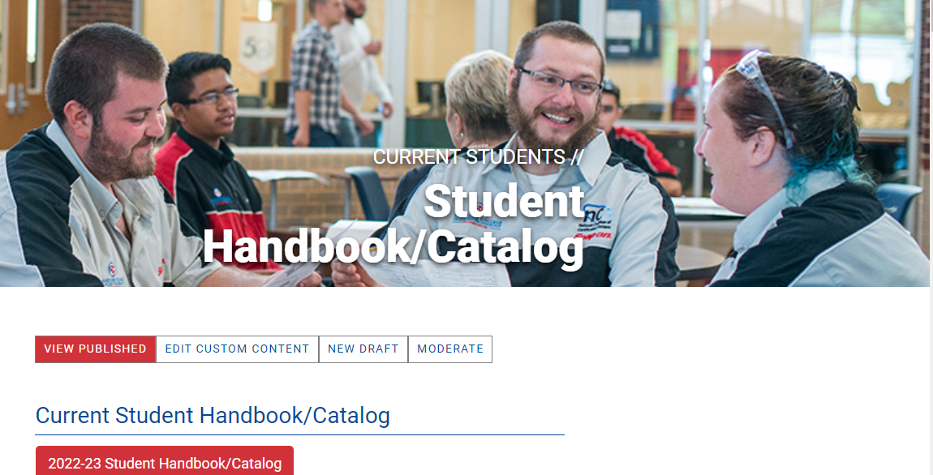
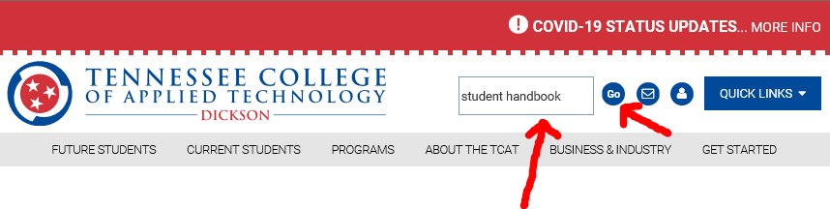

2023-2024 Student
Handbook & Catalog
Always available online
www.TCATDickson.edu
Notes:
The Student Handbook & Catalog is available online for your convenience. Students can search for information in the online version of the handbook by using the “Find” tool and searching by Keywords.
In the publication are TBR policies & guidelines that govern the TCAT’s, as well as the TCAT Dickson policies and procedures. Today we’ll review some of the major ones, as well as state and federal information the college is mandated to provide you. You are still responsible for reviewing the remaining information in the Handbook.

Slide 18
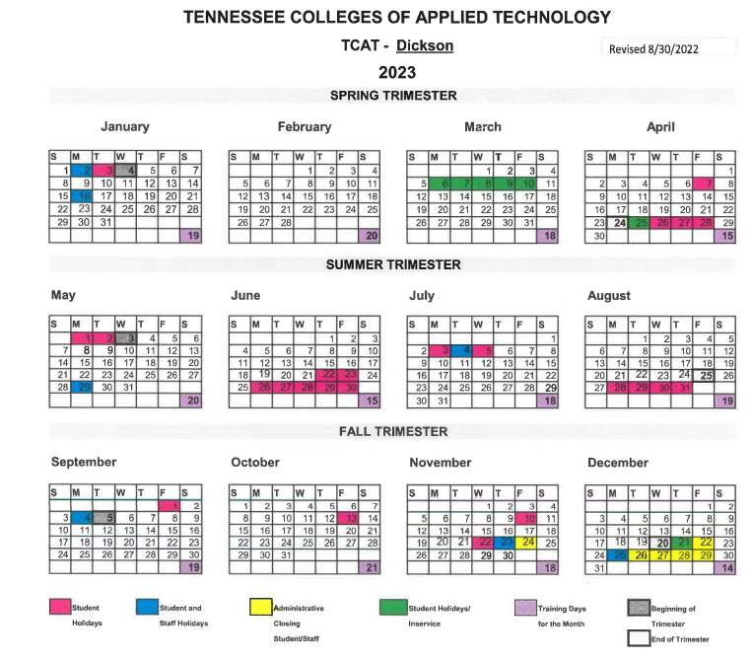

The college is in session year-round and the calendar year is divided into three 4-month trimesters, each consisting of 72 days or 432 clock hours.
Students are not required to attend classes on:
Student/Staff Holidays
Administrative Closing Days
In-Service Days
Notes:
Please plan your vacations and appointments around these days to ensure you’re at college when class is in session.

Slide 19
Examples:
Student ID# - S00123456
Campus Email - S00123456@TBR.edu
Password – TBR-Welcomefmmddl!
Help Desk – 615-366-4444
Student ID# &
Campus Email Address
Notes:
The day your application was put on the waiting list, you received an email assigning your Student ID # since college campuses no longer utilize social security numbers. Your S# will need to be used on all correspondence, emails, phone calls, with TCAT administration.
You also received notification how to set up your campus email address. We have also provided step by step instructions In your registration packet.
The Help Desk is available in case your account gets locked.
Now let’s talk about how to access your student portal.

Slide 20
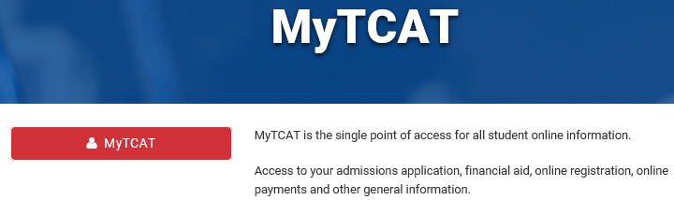

Accessing MyTCAT Portal
Via our website
Via internet
www.TCATDickson.edu
Enter portal.tbr.edu
in the address bar of your internet browser
Notes:
Your registration packet also has step by step instructions on how to access your student portal. You can reach the MyTCAT Portal in one of 2 ways:
Through our website under New Students or Current Students and then under MyTCAT
Through the portal.tbr.edu address entered in the address bar of your internet browser
P.S. Chrome is friendlier than Internet Explorer

Slide 21
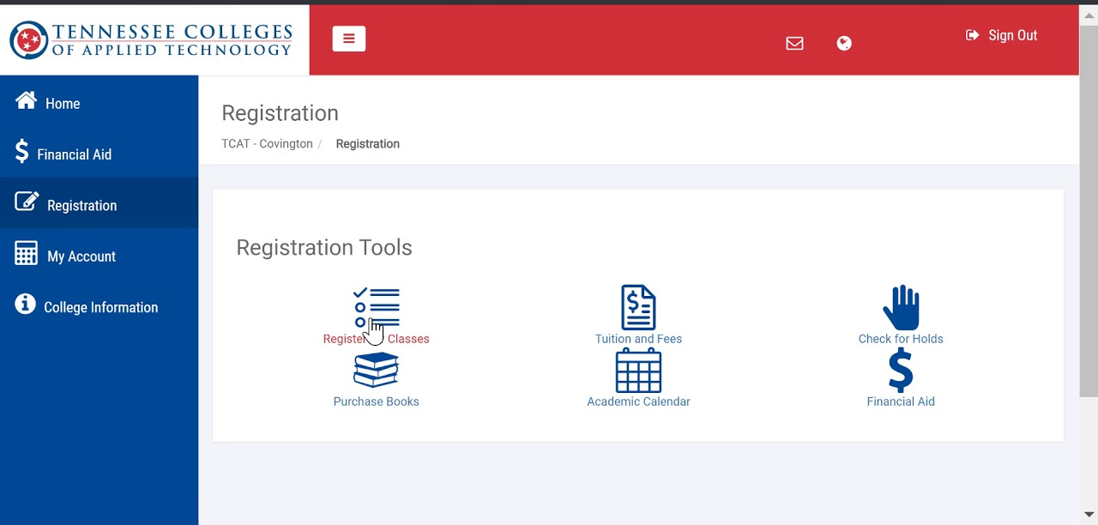
MyTCAT Portal
Tammy.Sullivan@TCATDickson.edu for Dickson
Lisa.Sullivan@TCATDickson.edu for Clarksville
Notes:
This is what the MyTCAT Portal home page looks like.
Here’s where you check your email.
It’s critical you check your email 2-3 times/day between now and your start date. Between now and your enrollment date, it’s highly likely the Financial Aid department will be emailing you regarding documents or missing information needed to complete your Financial Aid package. This is all VERY TIME-SENSITIVE info with deadlines. If documents required by the federal government or TCAT are not submitted in time, there’s a chance you could lose your seat for your start date. CHECK YOUR EMAIL 2-3 times/day.
As you can see, there’s many other functionalities in the MyTCAT Portal. In the portal, you will register for classes, you can review your financial aid package, pay tuition if using a credit card, and much more… There are also links for the calendar and handbook….
If AFTER you have exhausted all other methods of accessing your portal and you still cannot gain access, we encourage you to email Cheryl Sanders to get assistance in doing so.

Slide 22

Protecting Your Private Records
You can authorize TCAT to release your information to specific third-party individuals (parents, guardians, case workers, employers, etc...) by signing a FERPA Release Form.
FERPA is to
Education records
as
HIPPA is to
Medical records.
Notes:
If you are over age 18, you are considered an adult and we are not allowed to discuss any information regarding your enrollment with anyone other than you without a signed Release.
This includes information on financial aid, grades, attendance, conduct – anything….
If you know someone that will be needing to discuss your education with the college, please complete a FERPA Release Form and designate who we can release information. This release form is in your registration packet.

Slide 23
2023-24 Fee Assessments
Registered Clock Hours | Maintenance Fee | Technology Access Fee | TOTAL
1-40 | $201 | $45 | $256
41-80 | $271 | $45 | $326
81-135 | $410 | $45 | $465
136-217 | $714 | $73 | $797
218-340 | $1,153 | $73 | $1,236
341-432 | $1,290 | $73 | $1,373
Nursing & Welding
Add-on fee:
$100/term
Student Activity Fee:
$10/term
432 hrs
Notes:
Fees are assessed according to the number of classroom hours a student registers. A full term is 432 hours. If you do not start on the first day or if you are on a part-time schedule, your fees will be prorated according to the number of hours possible within the term.
Maintenance Fee is another term for Tuition. The Technology Access Fee represents dollars that all students pay and can only be used for technological advances that improves student life. Tuition and the TAF are reviewed for increases/decreases each Fall. There will be no increase for the 20-21 school year. The Practical Nursing and Welding programs have an additional add-on fee of $100/term and each student also pays a $10 activity fee/term that can be used for various student activities (currently graduation). The only fee subject to the refund policy is the Maintenance Fee (or tuition).
Fees are always due by the first day of each term. If a returning student does not have their tuition or a signed contract by a sponsoring agency on the first day of the term, they will be sent home and will be counted absent for that day. If tuition isn’t paid by the second and/or third day, they will lose their seat in the program and their enrollment will be terminated. They will have to reapply when they have funds in place to pay their tuition.

Slide 24
TUITION DISCOUNTS
ELIGIBILITY:
Provide appropriate documentation at or prior to registration
Enrollment is on a space available basis
FEE DISCOUNTS:
Spouse or child under the age of 26 of a full time TBR employee
Child under the age of 24 whose parent is a full-time certified Tennessee public school teacher
Child under the age of 24 whose parent is a full-time Tennessee state employee
Child under the age of 24 whose parent is a retired state employee
Tennessee resident students who are 65 years and older
Tennessee resident students with a permanent, total disability

Slide 25
TCAT Refund Policy
100% Refund
75% Refund
50% Refund
Official withdrawal from the program prior to the first day of class
Reclassification from Full-time to Part-Time
Cancellation of a class
Death of a student
Official withdrawal from the program within 0-10% of registered hours
Example:
432 hrs
x 10%
43.2 hrs
Official withdrawal from the program within 10%-20% of registered hours
Example:
432 hrs
x 20%
86.4 hrs
Notes:
If a student withdraws with the first 10% of their registered hours, they will receive a 75% refund of the maintenance fee only. If the student withdraws within 10-20% of their registered hours, they will receive a 50% refund. If they withdraw after 20% of their scheduled time, no refund will be given.

Slide 26

Buy New
Buy Used or Rent on most titles
Meet Our Bookstore Partner
Visit TCATDickson.edu for your program’s bookstore list and instructor required items
Create an account with Follett
Key in your S# to check your available funds
Select the items you want
Order books BEFORE 1st day of class; Delays may cause an instructor to send students home and be counted absent.
Order books ONE term at a time; Editions can change. TCAT is not responsible for books purchased in advance but then editions change.
bkstr.com/TCATDicksonstore
TCAT Bookstore Contacts:
Amber Smith – 615-420-2702
Stacey Langlois – 931-999-7112
Notes:
Please locate your one page BOOKSTORE ANNOUNCEMENTS flyer included in your registration packet. Order books before 1st day of class so you will be prepared. If there is a delay, students may be sent home and counted absent for not having their books.
We encourage students to order books one term at a time due to the possibility of editions changing. Please be aware that if students purchase books for future terms and the versions change, TCAT is not responsible.
You can view Follett textbooks online. Products are normally delivered in 48 hours, but may take longer during the COVID crisis.
You can charge your books to remaining financial aid (after tuition is covered). If you owe, you’ll pay at the Follett website.
Certain select items are still offered through the TCAT bookstore, ie: certification tests, uniforms, certain tools, etc… You can check with your instructor or come by the bookstore for more information on what is available at our campus.

Slide 27
Your TCAT Enrollment
How to Succeed We Are Student-Centered
at TCAT and Career-Driven!
… is your new job!
The College
… is your new place of employment!
Your Program Instructor
… is your new boss!
Notes:
Prepare yourself for a “work-related” college experience!
TCAT is operated as though you already have a career in the field you are interested in! This is practiced to equip you with appropriate expectations and to prepare you for a real-world experience to be more successful when you graduate.

Slide 28




What Do They Want?
Attitude
Attendance
Technical Skill
Notes:
Each program hosts Advisory Committee meetings – meetings with the industry leaders who do the hiring and managing in the real world. We want to make sure we are up-to-date in what we’re teaching as well as having the correct technology, machines, tools, curriculum, etc…
We ask them to tell us what to teach - we often hear the top three things employers are looking for.
Third was Skill – can they use a tool properly, can they program the CNC machine or the PLC correctly, can they measure accurately, Can they wire the electrical wires without shocking someone?
What was #2? Attendance – They must have you there when you are supposed to be at work. They must be able to depend upon you!
Number 1 thing employers ask for is a great attitude.
You have to learn to be a great employee, and though we’d all like to think that comes naturally, experience shows it does not. So TCAT teaches Work ethics. You will learn teamwork, respect, productivity, character, safety, appearance, cooperation, communication, organization – all these things and more mold a student in to a fantastic employee.
So remember…Attitude is the top attribute important to employers!!!

Slide 29
We’re SO Different!
Open Enrollment
Programs
Open Entry/Open Exit
More Start Dates
Competency-based
Individualized
Skills Training
Your Training as You Need It
We won’t hold you back
We’ll help you stay on track
More Hands-on Skills Learning
* NOTE: There is no Open Entry/Open Exit or Individualized Instruction for the LPN Program
Notes:
A major difference between the TCATS & other colleges has to do with teaching style. With the exception of our health care programs, TCATS operate as Open Enrollment programs. Most colleges enroll students on one specific start date each term; TCAT offers 3-4 start dates per term.
Starting on a later start date doesn’t mean you’re “behind”. Students graduate when they complete the curricula requirements, not when they attend a certain number of hours or days. Meeting competencies determines when you graduate (EXCEPTION: Practical Nursing, Dental Assisting, and Cosmetology.)
You’ll enroll in 1 program in 1 room with 1 instructor. The program has 20-32 different students, who are working towards different diplomas, studying different books, in different chapters, and are at different places in their educational journey. Therefore, we offer Individualized Instruction.
Typically, students operate off a syllabus, read textbook assignments, complete workbook assignments and labs, then prove mastery on test and exams.
This doesn’t mean we throw you out in the middle of the lake to either sink or swim. Instructors are available for one-on-one instruction and guidance as needed.

Slide 30
Mastery of Technology Foundations is required during the first Trimester!
  Applied Math, Reading, Language & Communication
Pre-test – Your opportunity to “test out” of strong subjects
Then you learn curriculum in the areas in which you did not test out.
Curriculum will set you up for success in your
technical program.
Technology Foundations
Notes:
In TN, all higher education students are required to master a basic skills requirement for their diploma or certificate. At 2-4 yr campuses, this is the “core curriculum” (Math, English, Science, Foreign Language, etc…)
At TCATS, with PN and Dental being the exception, all students must master Technology Foundations to receive a credential. We use computer software to measure basic skills mastery in Applied Math, Reading, Language and Communication.
First, you’ll take a pretest in each subject area, which gives you the opportunity to exempt yourself from training in the areas you’ve proven mastery. Then, you’ll complete the training in the areas not previously mastered.
Brushing up on your skills in these technical areas will set you up for success in your program of study, especially if you’ve been out of school for a while.

Slide 31
PLA Guidelines for Technology Foundations
Students are required to have 30 hours of Technology Foundations to graduate.
Students can attain credit toward their 30 hours from previous learning, testing out, or successfully completing the Technology Foundations course.
Student can attain credit toward their 30 hours from college Math and English courses, an ACT score of 19 or greater in Math, Reading, and Science or military training.
To receive prior credit, students must submit the PLA form AND official transcripts/reports to be evaluated. NOTE: ACT scores MUST NOT be older than 3 years.
PLA and supporting documents must be submitted by the end of the second week of the trimester.
PLA GUIDELINES
Notes:
In TN, all higher education students are required to master a basic skills requirement for their diploma or certificate. At 2-4 yr campuses, this is the “core curriculum” (Math, English, Science, Foreign Language, etc…)
At TCATS, with PN and Dental being the exception, all students must master Technology Foundations to receive a credential. We use computer software to measure basic skills mastery in Applied Math, Reading, Language and Communication.
First, you’ll take a pretest in each subject area, which gives you the opportunity to exempt yourself from training in the areas you’ve proven mastery. Then, you’ll complete the training in the areas not previously mastered.
Brushing up on your skills in these technical areas will set you up for success in your program of study, especially if you’ve been out of school for a while.

Slide 32

Customary Hours -
Pace and Progress Grading
Customary hours are the
average documented hours for each course module in each program
Grades reflect your rate of Pace & Progress, per your program’s policy.
Notes:
Each course code you study within your program has a set number of hours assigned to it that represents the number of hours an average person needs to complete that course code or block of curriculum, ie: MS Excel might = 100 hrs.
People learn at different rates and are also strong in some subjects and weaker in others. You may finish a course code in less than customary hours, which is great – you may end up graduating early! Or you may struggle with a course code and need a few more hours; that’s okay too, within reason. If you need way too long, your grades will reflect your pace as being too slow.
Your instructor will review your Program’s Pace & Progress policy in the syllabus and their orientation with you on your first day. If you find yourself struggling in a particular course, talk with your instructor about options available to help you with the material.

Slide 33
Grades are evaluated at the end of the term.
* Students must maintain a 60+ for each course code, as well as an overall average of 70+.
Failure to meet these standards by the end of the term or scheduled enrollment will result in termination.
Progress Scale
GRADE | RANGE
A | 90 – 100
B | 80 – 89
C | 70 - 79
D | 60 – 69
F | 0 - 59
* Practical Nursing, Dental Assisting, and Pharmacy Technology students must maintain an 80+ for each course code and an overall average of 80+

Slide 34
Performance is Graded in Three Areas
Theory
Tests Workbook Exercises Quizzes
Skill
Mastery in the Lab “Hands On” Skills Tests
Worker Characteristics
Attitude Cooperation Teamwork Appearance Attendance
Notes:
Students earn grades in three major areas – not just book theory! You will receive a Worker Characteristics grade each term. Theory and Skill grades are averaged together for a final grade in each course.

Slide 35

Americans with Disabilities Act &
Receiving Accommodations
If you have a disability or had an IEP in high school, contact Student Services today for an appointment if you want to seek ADA accommodations.
It's better to have accommodations and not need them, then to need them and not have them!
Notes:
When you completed the Blue medical form, you possibly listed disabilities or conditions that would help your instructor teach you more effectively with knowledge of those conditions. Listing those disabilities/conditions on the Blue Medical Form is NOT the same as requesting Accommodations through the ADA Americans with Disabilities Act.
If you had a disability in K-12, it was the State’s responsibility to ensure an equal playing field by providing learning or classroom accommodations. For example, if you were deaf in your left ear, an accommodation might be seat placement in the front row on the left side of the class. Of if you had a reading or processing learning disability, an accommodation might have been double time on tests and assignments.
Having the school automatically provide those accommodations STOPS when you graduated from high school. In the college world, it’s the student’s responsibility to apply for accommodations through the Americans with Disabilities Act (ADA). You can do this in the Student Services Department.
If you feel you will require accommodations in your current TCAT program, make an appointment to discuss ADA Accommodations. We want to set you up for SUCCESS!!!

Slide 36
Accommodations
TCAT-Dickson is committed to the success of all students. If a student needs to request reasonable accommodations for ADA, pregnancy, religious observances, etc., they will need to contact Student Services so we can provide you with the ADA packet and options for continuing your enrollment.
REMINDER: Absences for ADA Accommodations, pregnancy, and religious observances must be requested in writing and in advance BEFORE you require the accommodation.

Slide 37
Health and Accident Insurance
TCAT-Dickson does not provide health or accident insurance for students.
Students interested in obtaining health insurance coverage can access information about the TBR Student Health Insurance Exchange online at https://www.ahix.com/ or by calling 1-800-647-4104.

Slide 38
Attendance Policy
New student orientation

Slide 39

Your attendance affects so much!
Your work ethics grade
Your financial aid ~ $ $ $
Your future employability
Notes:
Remember how important attendance was to employers? You’ll be expected to go to work when you’re scheduled, so we expect you to be here when college is in session. If you miss a lot of work, you’ll probably be fired. If you miss a lot of class time, you’ll probably be terminated unless you can provide valid reasons and documentation. Absences will affect your progress as well as your financial aid.
Each full-time student who is enrolled for the entire term has 42 hours of allowable time off each trimester to “manage” for emergencies. Those hours are yours to save and protect throughout the trimester. You could “burn them as you earn them”, but in the end, you’ll likely be the one getting burned. Hang on to these hours for “when life happens” – like medical or dental appointments, legal appointments, sick family members, deaths in the family, home or auto repairs, etc…
It’s the student’s responsibility to keep up with your absence hours and documentation.

Slide 40
No Excused Absences...
(We can't say you're here if you're not...)
Not figured in Suspension Calculations:
Jury Duty
Mandatory Military Service, ie: Reserves
Must be pre-documented
Attendance Policy
Notes:
NO absences are considered “excused” as students earn financial aid for every minute they are present in the classroom. We cannot state you are present if indeed you are not here.
However, jury duty or military service is not calculated towards suspension for attendance counseling purposes.

Slide 41

Accountability - Signing In & Out
Always sign in & out at the time of arrival & departure
Ensure your instructor knows your whereabouts
For safety's sake!
Attendance Policy
Notes:
If you need to leave class for any reason, it’s imperative that you sign out. If there’s a fire in the building and we cannot account for you because you did not sign out, this may put people in harm’s way trying to find you.

Slide 42
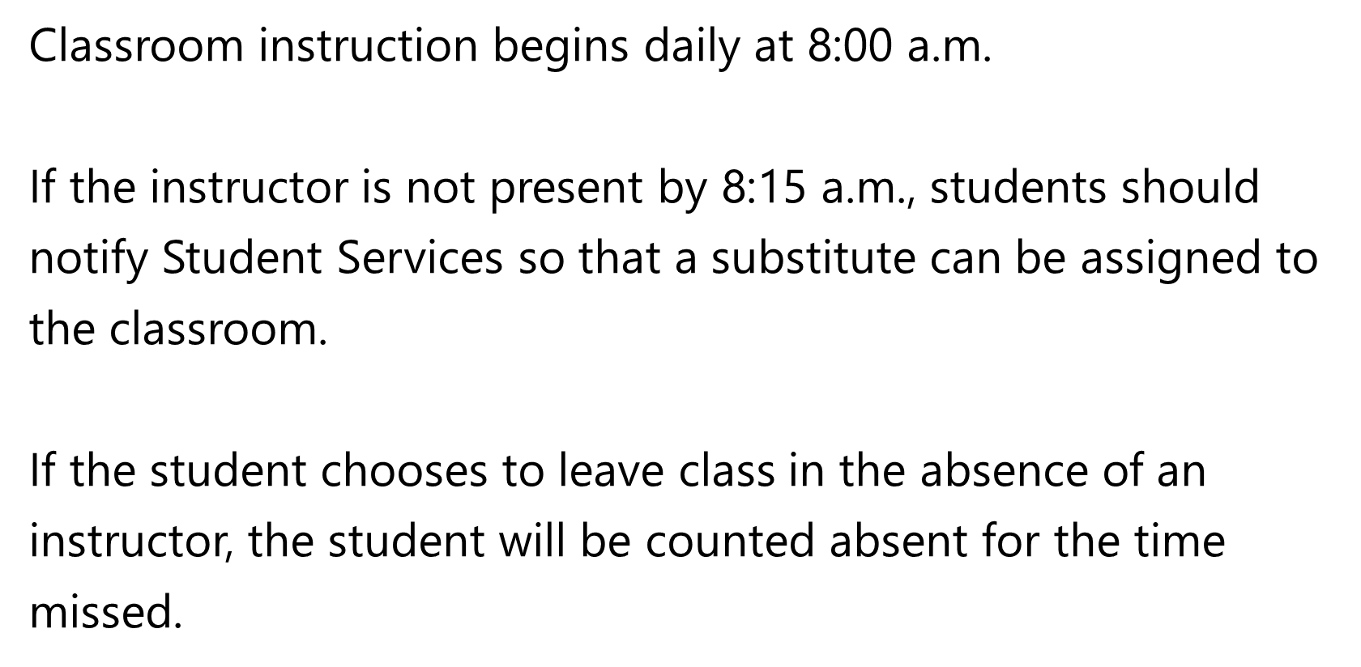
Attendance Guideline
Attendance Guidelines
Notes:
If you need to leave class for any reason, it’s imperative that you sign out. If there’s a fire in the building and we cannot account for you because you did not sign out, this may put people in harm’s way trying to find you.

Slide 43

Automatic Withdrawal
Just like for an employer, ALL absences MUST be reported to your instructor DAILY!
Email, call, or text your instructor when you have to miss class!
Attendance Policy
If you are absent 3 consecutive days
without notification, you will have
automatically withdrawn yourself
from the program and the college.
Notes:
What would happen if I was not here today and did not contact my supervisor? I would probably be fired.
It is the student’s responsibility to notify their instructor if they are going to be absent. If a student misses 3 consecutive days without notifying their instructor, they will be automatically terminated and will have to complete a new online application for enrollment to re-apply.

Slide 44
Attendance is Prorated based on your Enrollment
(how many hours you enrolled for)
5.5% Instructor Counseling – occurs when absences reach 5.5% of the hours you registered for.
Attendance Policy
Example: 432 hrs
x 5.5 %
24 hrs
222 hrs
x 5.5 %
12.21 hrs
Ex: after 1st of term
Financial Aid & Worker Characteristics Grades are affected
Informed of Suspension & Appeal policy
Notes:
When absences exceed 5.5% of registered hours, students will receive counseling by the instructor to remind them of how many absence hours they have accrued.
NOTE:
The instructor will remind the student how absences adversely affects their work ethics grade and financial aid and will review the Suspension and Appeal policy that will occur if absences exceed 9.7% of registered hours.

Slide 45
Attendance is Prorated based on your Enrollment
(how many hours you enrolled for)
9.7% Student Services Counseling – occurs when absences EXCEED 9.7% of the hours registered for.
Attendance Policy
Example: 432 hrs
x 9.7 %
42 hrs +
222 hrs
x 9.7 %
21.5 hrs +
Ex: after 1st of term
Receive Suspension Memo
File Appeal packet within 3 days with Appeal Committee, then college President
Notes:
When absences EXCEED 9.7% of registered hours, or 42.5 hours for a full time student, you will receive a suspension letter with the option to submit an appeal within three school days.

Slide 46
Appeals Process
Appeal Packet consists of:
Absence Report
Written Appeal
Absence Documentation
Transcript
Attendance Policy
Appeal Committee consists of 4 rotating faculty/staff who:
Review appeal packet
Make individual recommendations to the college president to grant or deny appeal
Notes:
If the student chooses to appeal the suspension, they will submit a packet to the appeals committee for review and continue attending class throughout the appeals process.
Your appeal has 2 purposes:
Explain your absences
Convince the committee why they should recommend keeping you in college
Documentation for your absences needs to be from verifiable sources on original letterhead, signed and dated by certifying official, with a verifiable phone number.
IMPORTANT - Get documentation for all absences – anything that proves why you were not in class.
The committee will review the appeals packet and make recommendations to grant or deny the appeal. It is then forwarded to President Summers for a final decision.

Slide 47
Presidential Determination of Appeal
Appeal Granted
Appeal Denied
Attendance Probation
No more absences until end of trimester
Except documented rarest case of emergency
Start fresh next trimester
Enrollment is Terminated
Can re-apply anytime online
Must sit out a full term
Waiting List policy applies
Attendance Policy
Notes:
If the student chooses not to file an appeal or their appeal is denied, they will exit the program and must sit out for the next full trimester. They can then submit a new online application to reapply and their application will go back on the waiting list for re-enrollment.

Slide 48

Tardiness – 30 Minute Clock
Tardy Counseling Process
5th Tardy – Instructor counseling
6th Tardy – Student Services counseling & submission of Tardy Success Plan
7th Tardy – Referred to college president for termination of enrollment
All time missed from class is recorded on a 30-minute clock
Students are expected to be
in class AND on task
Monday – Friday
8:00am – 2:30pm
Attendance Policy
Notes:
Being late to class or returning from breaks or lunch are considered tardies and are a part of the attendance policy. Counseling will begin upon a student receiving their 5th tardy and upon receiving their 7th tardy they will be referred to the President for termination.

Slide 49


Inclement Weather or Emergencies
Automated Notification
Alerts – if you opted in
www.TCATDickson.edu
Our Facebook page
News Channel 4
News Channel 5
Attendance Policy
www.TCATDickson.edu
Notes:
When you are watching closing notifications, please remember we are TCAT DICKSON. TCAT Clarksville and TCAT Franklin are branch locations of TCAT Dickson. Also, just because Dickson County School Systems may be closed, that does not apply to us. So be sure the closing actually says TCAT Dickson.

Slide 50
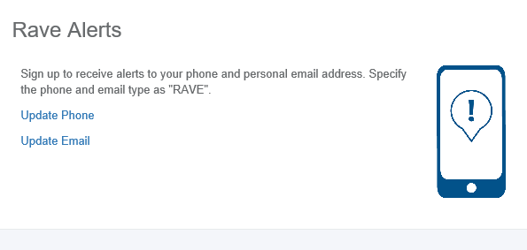

Automated Notification Alerts
Notifications
Inclement Weather announcements
Weather Emergencies
Other Campus Emergencies
Notes:
You can opt in to receive school notifications through the RAVE Automated Notification Alert system on the HOME page of your MyTCAT Portal.
If you set up your TCAT portal to receive notifications, you will receive a notification once a decision has been made to close or delay school. Closings will also be listed on our website and Facebook pages. Please do not call the college front office to inquire whether we are in session.

Slide 51
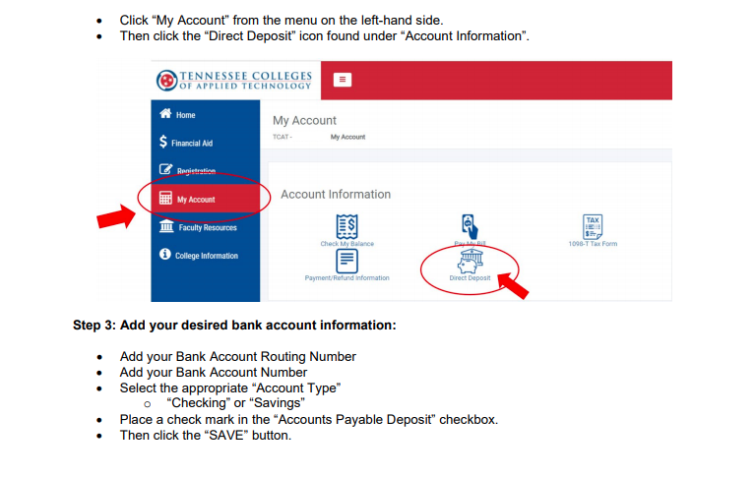
DIRECT DEPOSIT

Slide 52

Student
Conduct
Basics
Designated Areas for
Parking
Smoking
Dress Codes
Program-related
Use good hygiene
Wear Student ID
Notes:
Students are permitted to park only in student parking and are on a first come basis. Please do not park in handicapped parking unless you have a placard; Please do not park in spaces designated for faculty, in driveways, loading zones, or fire and safety lanes.
Smoking is permitted in designated outside areas. Benches and picnic tables are for non-smoking breaks only Please use receptacles to dispose of your cigarette butts. Rules for the use of e-cigarettes or smokeless tobacco will be treated the same as tobacco products.
DRESS CODE:
Appropriate dress will be defined by your instructor. While in class, each student should dress as a representative of what the industry they are preparing for requires in the work place. Safety glasses are required in all shop areas; loose clothing is not permitted when operating machinery. Some programs may require certain clothing items to be purchased such as uniforms, steel toe boots, pants, shirts, etc. Offensive clothing is prohibited.
Along with appropriate clothing, all students should maintain good personal hygiene such as bathing, washing your hair, brushing your teeth, and wearing clean clothes.
ID BADGES
Students must wear their photo ID badges at all times while on campus. They will be required to show identification before receiving financial aid checks. If you lose your ID, you can get a replacement for a fee of $5.00 plus tax.
Remember all students are required to wear a face mask while on campus. You will need to provide your own mask.

Slide 53
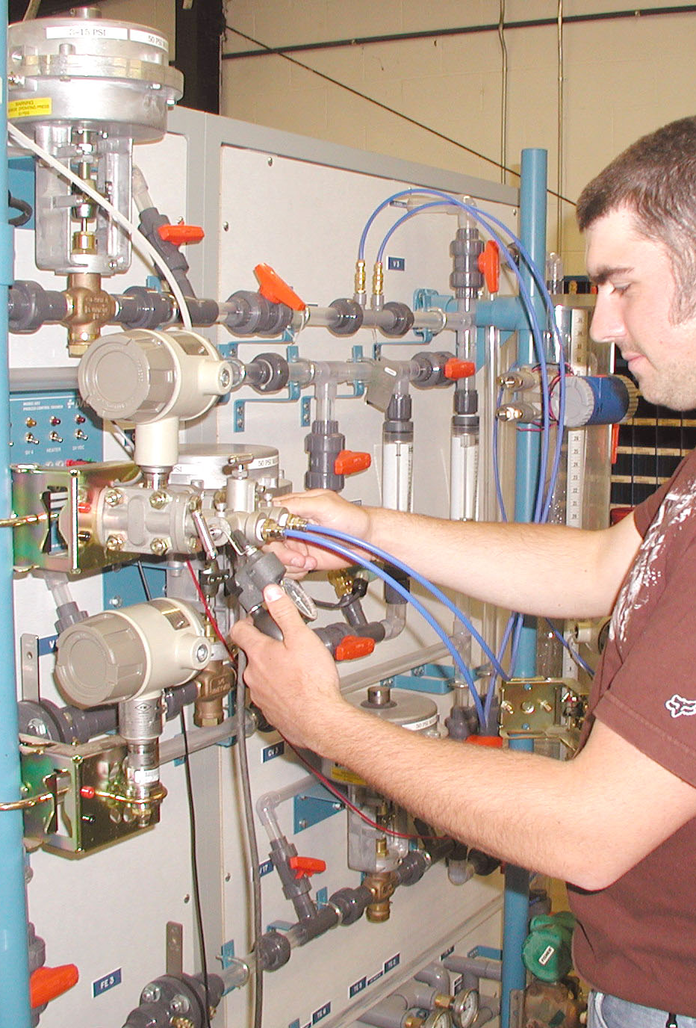

TCAT Policies & Procedures
Two Underlying Guiding Goals:
Everyone deserves to be SAFE
Everyone deserves an atmosphere that promotes LEARNING!
CONSULT your HANDBOOK for the
DO's and DON'T's and other policies!
Notes:
Our President feels very strongly that everyone remains safe on our campuses and that everyone thrives in a conducive learning environment. Our society is seeing uncertain times and having to deal with campus and workplace violence. It’s critical that we maintain safety and that these goals are met daily!

Slide 54
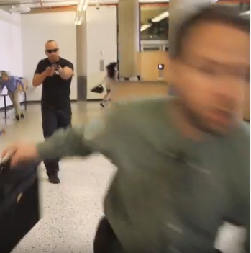
Safety & Security Matters!
Annual Security Report - available for review in
Student Services and published in October
Emergency
Preparedness
Guide – know
where it's located
for emergencies
Active Shooter Plan
Notes:
All colleges must report crime activity on campus. You may review the updated Annual Security Report every October in Student Services.
Every program has an Emergency flip guide strategically placed in the classroom. If your instructor steps out of the classroom and something occurs like a fire, student altercation, medical emergency, active shooter, etc… the flip chart tells you exactly what to do in case of various emergencies.
During your class orientation, your instructor will show you a short video on an Active Shooter Scenario for the college. Each instructor has an effective plan in the case of a shooter on campus, and you need to be prepared. If your instructor does not review this plan with you, ASK about it!

Slide 55


Off-campus escorts are available
Instructors are responsible for what occurs in their classroom.
Students exhibiting potentially unsafe behavior, not following directives, or not "on task" will be sent home and will accrue absence hours for the day.
Escorts are available
to keep us all safe.
Notes:
Instructors are held accountable for classroom conduct and atmosphere.
If you are asked twice to remove yourself from campus, a professional will escort you off the campus.
The idea is to “diffuse potentially volatile” situations by “nipping things in the bud” and “removing catalysts”. If you’re asked to leave campus, it’s not an automatic judgment of fault or penalty – it’s rather to ensure nothing explodes that could otherwise harm the students involved, surrounding students, the instructor, etc… The issues at hand WILL BE discussed the next morning in the Counselor or Student Services Coordinator office and we’ll all reach a peaceful and safe resolution.

Slide 56
Managing Conflict in the
Classroom
Instructor – ALWAYS FIRST!
Student Complaint Policy
Counselor for student issues
Campus Coordinator or Student Services Coordinator for instructor issues
Vice President
President
TBR
Allied Health Coordinator for medical program issues
Notes:
For any class conflict – attempts to resolve must start at the lowest level possible following the school’s chain of command.

Slide 57
Discrimination & Harassment
TCAT does not Discriminate on programs or activities
based on these Protected Statuses:
Race
Color
Creed
Age
Religion
Disability
Veteran Status
Genetic Information
Ethnicity
National Origin
Sexual Orientation
Gender Identity
TCAT takes immediate action to eliminate Harassment, prevent its recurrence, and address its effects.
It's the LAW!
Laura Travis: Vice-President & Title VI & IX Officer
Notes:
Discrimination and Harassment are important issues you will face in the work world and even in a college setting. Basically, it’s against the law to treat people differently based on certain “protected statuses”. Most people think of race or gender or age when people talk about protected statuses, but it also includes religion, national origin, or gender identity.
If anyone mentions the Discrimination or Harassment the situation must be investigated. This always involves the Vice President/Title 6 & 9 Officer, and sometimes involves TBR lawyers, because IT’S THE LAW! Even if both parties decide against pursuing the issue, we MUST investigate. It’s illegal not to!

Slide 58

Student Services Cares
TCAT has numerous community resources to help when Life Happens...
Notes:
After some of the negative things we’ve had to cover, we want you to know TCAT CARES about its students! Juggling life and college can be challenging, and sometimes can seem impossible. Don’t suffer in silence, and certainly don’t quit school! Our counselors and management staff know of many community and professional resources that can handle the BIG issues and provide assistance to get you over the hurdles. So whether it’s needing gas to get to school, food for your family, or clothing to dress professionally – let us know. We just may know someone who can help you get through it!
Remember…Strong people ask for help!!! Weak ones suffer in silence…

Slide 59


RESOURCES AVAILABLE IN STUDENT SERVICES
Drug and Alcohol Abuse Prevention Program
Health Risks
Prevention Assistance Programs
Anonymous Survey regarding use of drugs/alcohol
Suicide Prevention Program

Slide 60

NEWTON MILITARY FAMILY RESOURCE CENTER
* One-stop shop for military-affiliated student support and services
* Reception space, lounge, computer lab, conference room, and work stations
* Hub for community partner support and services
* Services offered to Student Veterans:
Vets Success on Campus (U.S. Veterans Administration)
Montgomery County Veterans Service Organization
Stephen A. Cohen Military Family Clinic
Veterans Administration Whole Health Coaching Program
Operation Stand Down Tennessee – Operation Commissary
* Questions:
Walt Lord, Major General, U.S. Army (Retired)
426 College Street
Clarksville, TN 37024
lordw@apsu.edu
931-221-7549

Slide 61
Financial Aid
New student orientation

Slide 62

For All Things Financial....
Always Go to the Experts!
Dickson/Clarksville
Jordan.Parrish@TCATDickson.edu
615-551-8757
jamiee-lee.weber@tcatdickson.edu
931-444-6527
Notes:
The Financial Aid Department is trained in providing you with answers to your questions. Ask the EXPERTS! And please remember – everyone’s Financial Aid is DIFFERENT! Your neighbor’s Financial Aid is not yours and vice-versa.

Slide 63
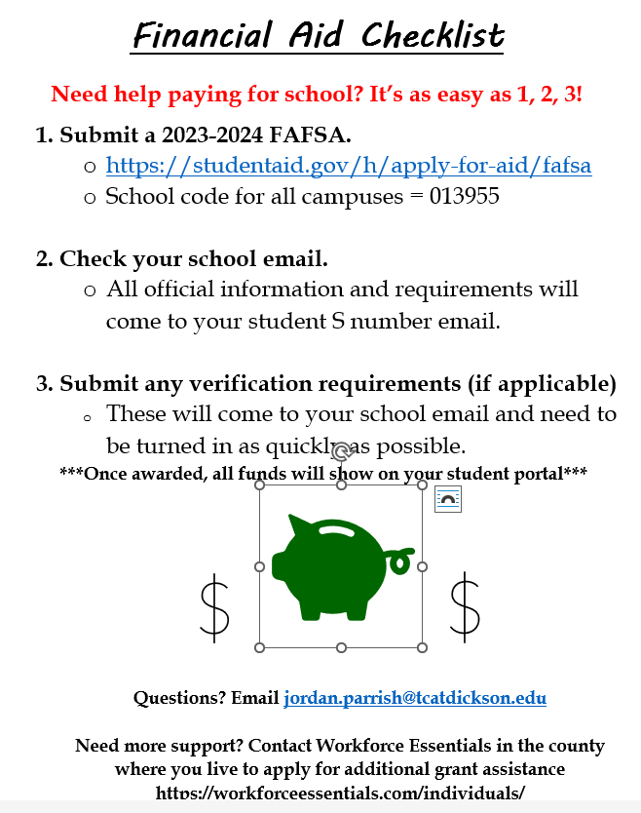

Slide 64
Free Application for Federal Student Aid
FAFSA.ed.gov
“ONE STOP SHOP”
Complete one application for many different types of federal and state financial aid funding
Federal Pell Grant
Wilder-Naifeh Technical Skills Grant, aka “Lottery”
TN Student Assistance Award (TSAA)
TN Promise – FREE tuition for TN high school seniors
TN Reconnect – FREE tuition for TN Adults
School Code 013955
Financial Aid
Notes:
The FAFSA is a “One Stop Shop” application where you can apply for different types of federal and state financial aid by completing just ONE application.
It’s FREE, so if you’re on a website where they try to charge you, leave immediately – you’re in the wrong place!
1. The main type of aid is the Pell Grant which is based on income but lots of other factors also. $6,345/year max
2. The WNTSG or as we call it, the Lottery, is NOT based on income, so most of our students receive this aid, is $2,000/year max
3. TSAA is a first come, first serve grant so complete your FAFSA as soon as it’s available in October. $1,000/year max
4. TN Promise is a last dollar scholarship for TN high school seniors that offers FREE tuition ONLY (no books or other fees) and has eligibility requirements such as FAFSA deadlines, meetings, and community service hours
5. TN Reconnect is a last dollar scholarship for TN adults deemed as independent status by FAFSA that offers FREE tuition ONLY (no books or other fees)
A LAST DOLLAR SCHOLARSHIP means you must use all other forms of financial aid first, and then TN Promise or TN Reconnect will pick up to cover the balance of the tuition.
Again it does NOT cover books, tools, supplies = tuition ONLY!!!

Slide 65
Veteran’s Administration Educational Benefits
VA.gov
Chap 30 – MGIB or Montgomery GI Bill
Chap 31 – VA Voc or VA Vocational Rehabilitation
Chap 33 – Post 9/11
Chap 35 – SDEA or Survivors & Dependents Educational
Assistance
Veteran Spousal Educational Benefits
MilitaryOneSource.mil
MyCAA – My Career Advancement Account
Financial Aid
Notes:
AT TCAT, we LOVE our Veterans! As a matter of fact, the Clarksville campus student population typically runs about 25-35% veterans! Each Fall we honor our vets with a special ceremony.
Veteran’s include:
1. MGIB Ch 30 – benefits are paid directly to the veteran. Must submit COE, DD214 & college transcripts
2. VA Voc Ch 31 – authorization covers tuition, books & supplies & paid to the college. Must submit VA Voc authorization, DD214 & college transcripts
3. Post 9/11 Ch 33 – covers tuition & the LPN/Welding fee w/ other benefits paid directly to the veteran. Must submit COE, DD214 & college transcripts
4. SDEA Ch 35 – benefits are paid directly to survivor spouse or dependent. Student must call in to VA monthly to have payment released. Must submit college transcripts.
5. MyCAA - authorization covers tuition, books & supplies & paid to the college. Must submit VA Voc authorization.

Slide 66
Outside Sponsors or Agencies
Workforce Essentials
West KY Workforce
Mid-Cumberland Human Resource Agency
State Vocational Rehabilitation
Fee Waivers for State of TN employees & dependents
Fee Discounts for Public School teachers
Department of Children’s Services
Various Scholarships, some of which are …
  Access & Diversity Scholarship
  Gene HAAS Scholarship
  James Berdet Brown Scholarship
  Many more
Financial Aid
Notes:
Listed are other third party agencies that help our students with financial assistance for school. If you have questions on how to obtain this assistance, please contact our Financial Aid Department.

Slide 67



Slide 68
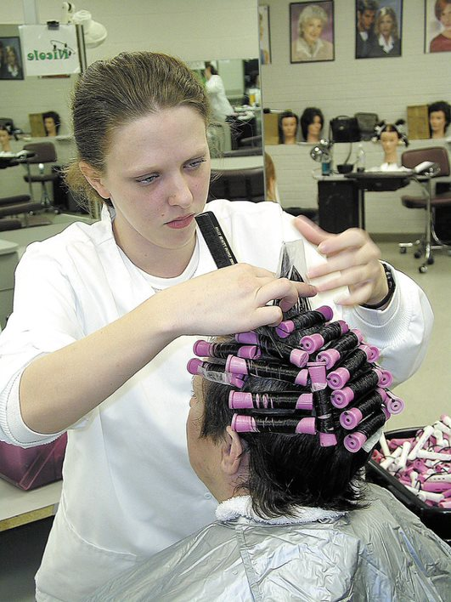
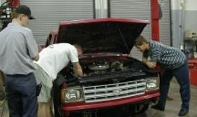
Live Work = Great Experience
Programs may accept repair projects to enhance students’ learning experiences, accepted solely at the instructor's discretion.
TCAT also offers a cosmetology salon that is open to the public.
Live Work programs charge nominal fees, and clients sign acknowledging no liability.
ONLY CURRENT STUDENTS AND STAFF are eligible for Live Work projects, except the Cosmetology salon.
Notes:
One fantastic aspect of learning at TCAT is working on REAL projects… Real people’s vehicles, HVAC units, Real welding projects, Real client’s hair and nails…these are referred to as LIVE WORK projects.
It reinforces what you have learned in your program by giving you hand-on experience.
* * * Don’t forget the disclaimer at the bottom in the blue band…

Slide 69

Student
Life
Activities
National Technical Honor Society
Statewide Outstanding Achievement Recognition
SkillsUSA Competitions
Student Government Association
Student Veteran's Association
Annual Veteran's Honor Recognition
Holiday Food Drive
Graduation Commencement Ceremony
Health Fairs
Blood Drives
Notes:
As for all things in life – You get out of it what you put in it…We hope you get involved and HAVE FUN!!!

Slide 70
Nursing Notes
New student orientation

Slide 71

Immunizations, Physicals
and Screening Documentation
Return documentation of Physicals & Immunizations with your Orientation paperwork
Background and Drug Screens are sent to the college automatically – do not mail in
It’s URGENT to complete the screening processes NOW!
Nursing Notes

Slide 72

Nursing Notes

Slide 73

LPN Dress Code
You’ll be notified when the uniform vendor will be on campus for sizing & orders
Specific colors/styles with college patches are required
Until uniforms arrive, casual street clothes are the code – but no shorts or tank tops
Nursing Notes

Slide 74



Nursing Notes
ORDER THROUGH FOLLETT
BEFORE FIRST DAY OF CLASS

Slide 75


Nursing Notes

Slide 76
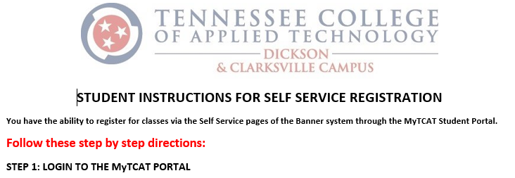
Find your Registration Directions
Self-Registration
Time to Register! Follow your directions.
We’re here to assist if you need help!
https://tcatdickson.edu/about/contact-us
Connie.Shaw@TCATDickson.edu
for Dickson (615.420.7364)
Stacey.Proteau@TCATDickson.edu
for Clarksville (615-441-6221)
Notes:
Time to register!!! Please locate the 4 page SELF-SERVICE REGISTRATION STEPS in your orientation packet.
You will use these steps to register yourself for college after this orientation.

Slide 77


Come join us!
Notes:
We can’t wait to congratulate you on your accomplishments at Graduation! Watching you walk into your future is what we live for ~
What a day to celebrate that will be!
https://forms.office.com/r/38aQhLe8Lm

